Slide 1

Classical ML for Text Classification
Week 4
CSY3055 – Natural Language Processing
Dr Oluseyi Oyedeji

Slide 2
Learning Goals for Week 4
By the end of week two, you should be able to:
Explain the difference between generative and discriminative models.
Train and compare Naïve Bayes, Logistic Regression for text data.
Use TF-IDF features and evaluate results with precision, recall, and F1.
Reflect on bias and fairness in text classification.

Slide 3
Relevance
Classical ML still powers real-world NLP applications
Many spam filters and sentiment tools uses the algorithm
It builds the foundation for understanding modern deep learning.

Slide 4
Today’s Session
Generative vs Discriminative models
Naïve Bayes
Logistic Regression
Evaluation metrics
Practical: IMDB sentiment classification
Ethical reflection on bias

Slide 5
Introduction

Slide 6
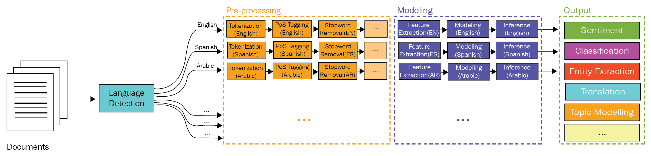
Why Classical ML Still Matters
Before deep learning became dominant, classical ML algorithms powered nearly all text classification systems
Spam filters
Sentiment analysers
Topic classifiers, and
Recommendation engines.

Slide 7
Why Classical ML Still Matters contd.
Even today, models like Logistic Regression, Naïve Bayes, and SVM are still considered:
Lightweight: suitable for fast and real-time inference.
Interpretable: we can inspect learned weights and understand why a decision was made.
Strong baselines: good starting point before moving to neural architectures.

Slide 8
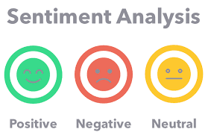
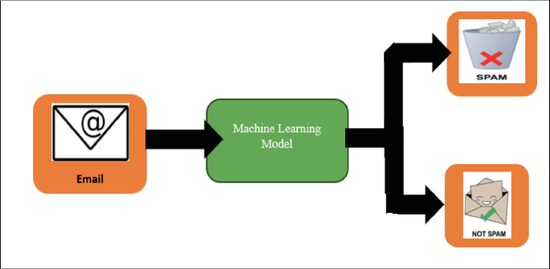

Example applications
Email spam detection
Sentiment classification on reviews
Detecting toxic or fake comments

Slide 9
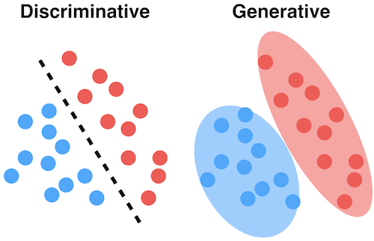
Classical ML Paradigms
Classical machine learning models can be broadly divided into generative and discriminative approaches based on what they learn from data.

Slide 10
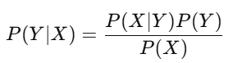
Generative Models
Learns the joint probability P(X,Y)=P(X|Y)P(Y) i.e. how the data X is generated for each class Y.
It can generate new samples and classifies using Bayes’ rule:
Example: Naive Bayes, Gaussian Mixture Models.

Slide 11
Discriminative Models
Learns the conditional probability P(Y|X) or a direct decision boundary between classes.
It focuses on distinguishing classes rather than modelling how data is produced. Example: Logistic Regression, Support Vector Machines.

Slide 12
Generative vs Discriminative Models
A generative model = understand what a “positive” review typically looks like and what a “negative” one looks like.
A discriminative model just looks for the boundary between positive and negative reviews.

Slide 13
Naïve Bayes

Slide 14
Naïve Bayes Classifier (Generative Model)
Naive Bayes is a probabilistic classifier based on Bayes’ Theorem assuming feature independence.
Widely applied in NLP tasks
text classification, spam detection, and sentiment analysis.
Efficiently manages large vectors of word frequencies or binary indicators in documents.
Provides scalable, interpretable solutions with clear probabilistic predictions.

Slide 15
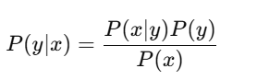
Naïve Bayes Classifier contd.
It uses Bayes’ Theorem to compute the probability of a class given words in a document
P(y) : prior probability of class (e.g., 0.5 for positive, 0.5 for negative)
P(x|y): likelihood of the features given class
“Naïve”: assumption: words are independent given class

Slide 16
Variants of Naïve Bayes
Type | Use case
Multinomial NB | Word counts or term frequencies
Bernoulli NB | Binary word presence/absence

Slide 17
Example
If “fantastic” and “excellent” appear often in positive reviews:
The class with the higher posterior wins.

Slide 18
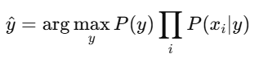
The Core Idea Behind Naïve Bayes
Bayes’ Theorem
For Prediction
“Naïve” assumption: features are independent given the class.
E.g. Predict if an email is spam using word probabilities.

Slide 19
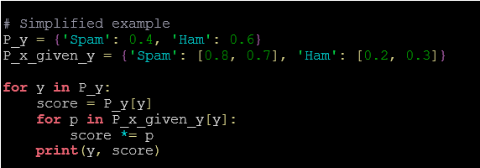
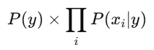
The Core Idea Behind Naïve Bayes contd.

Slide 20
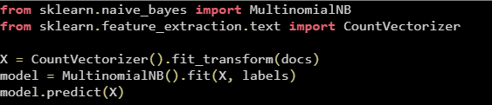
The Core Idea Behind Naïve Bayes contd.
The library computes (P(y)) and (P(x_i|y)) internally.
Focus on data preparation, not the probability math.

Slide 21
The Core Idea Behind Naïve Bayes contd.
“Naïve Bayes was built for counts. TF-IDF still works, but it bends the probabilistic assumption a bit.”
Feature Representation | Theoretical Fit | Common Use | Notes
CountVectorizer | Exact for Multinomial NB | Text classification | Models actual word counts
TF-IDF Vectorizer | Approximation | Works empirically | Uses weighted frequencies, not true probabilities

Slide 22
Example
If “fantastic” and “excellent” appear often in positive reviews:
The class with the higher posterior wins.

Slide 23
Weaknesses of Naïve Bayes
Independence assumption unrealistic
Sensitive to rare words
Can underperform on complex boundaries

Slide 24
Logistic Regression

Slide 25
Logistic Regression (Discriminative Model)
Logistic regression is widely used in NLP to classify data into categories like spam detection or sentiment analysis.
The sigmoid function transforms linear combinations of features into probabilities between 0 and 1 for classification decisions.
Multinomial Logistic Regression uses softmax function for multiple classes
Simple and interpretable, making it ideal for practical NLP applications.
Key aspects include the cost function and optimization techniques essential for training logistic regression models.

Slide 26
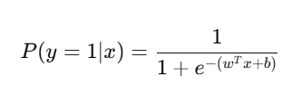
Logistic Regression contd.
Logistic Regression learns weights for each feature (word) that best predict the target class:
(x): vectorised features (e.g., TF-IDF values)
(w): learned weights
(b): bias term

Slide 27
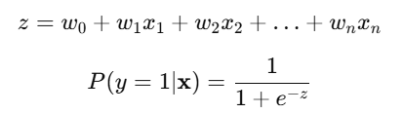
Logistic Regression Core Formula
The sigmoid function turns any number into a value between 0 and 1.
(P>0.5) → class 1 (P≤0.5) → class 0

Slide 28
How Logistic Regression learns
Logistics regression simply learns by:
Adjusting weights (w_i) to make predicted probabilities match true labels.
Using cross-entropy (log-loss) to measure error.
Learning which features push a text toward or away from a class.
Word | Weight | Meaning
“free” | +2.1 | more spammy
“meeting” | −1.3 | more normal

Slide 29
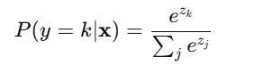
Multiclass Extension
Binary uses sigmoid → one probability (0–1).
Multi-class uses softmax → many probabilities that add to 1.

Slide 30
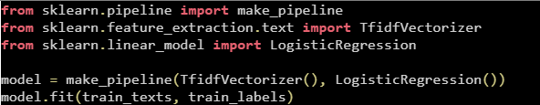
Logistic Regression in an NLP Pipeline
Vectorizer → numbers → Logistic Regression → class label

Slide 31
Comparison with Naïve Bayes
Feature | Naïve Bayes | Logistic Regression
Type | Generative | Discriminative
Assumptions | Features independent | None
Speed | Very fast | Slower but accurate
Interpretability | High | High
Use case | Spam detection, baselines | Sentiment analysis, real-time predictions

Slide 32
Model Evaluation

Slide 33
Confusion Matrix – Binary Classification
 | Predicted Positive | Predicted Negative
Actual Positive | TP | FN
Actual Negative | FP | TN

Slide 34
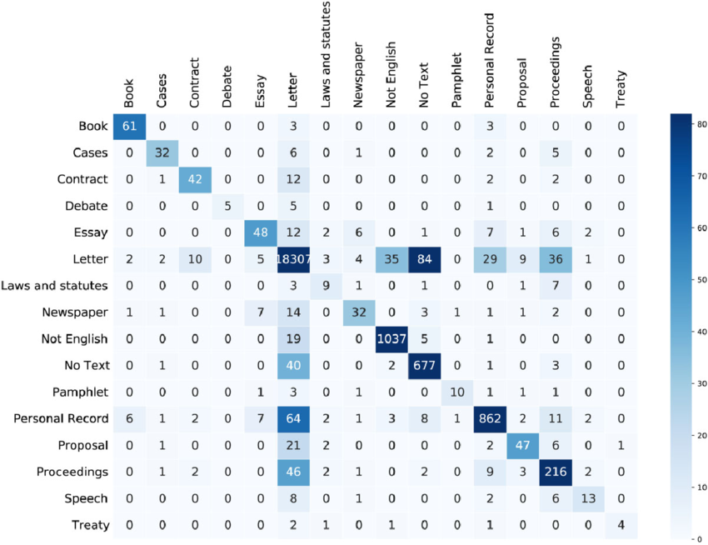
Confusion Matrix – Multi-class Classification
Figure: Multiclass Confusion Matrix Showing Model Performance Across Document Categories

Slide 35
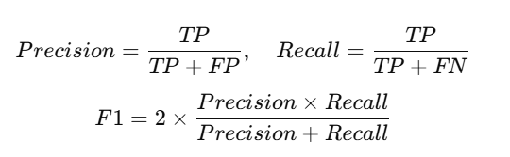
Metrics
Interpretation:
Precision → Of the predicted positives, how many were correct?
Recall → Of all true positives, how many were detected?
F1-score → Balance between the two.

Slide 36
Ethical Dimension: Bias in Text Classification
Spam filters and sentiment models can unfairly treat minority language patterns:
Non-standard English or dialect messages misclassified as spam/toxic.
Bias introduced through under-representation in training data.
How could you detect this bias?
How can data collection improve fairness?

Slide 37
Practical & Wrap-Up

Slide 38
Thank you

